Slide 1



Digital
Games
Game Design - 201
Tue 9:30-12:15pm C-456
Prof. McClure

Slide 2
Announcements

Slide 3
Last class...

Slide 4

Game 1 pitches

Slide 5
Gather into your groups (15 mins)
Each team member should share their prototype with the group
How do they differ?
How are they similar?
Is one more effective than the others?
How does each one serve the experience you are designing for?

Slide 6
Dear Groups,
How has your concept changed since your pitch? Where are you at in production? Remind us of your unique game’s unique take on STG mechanics. What is the experience you are designing for?
Notes:
Present to class

Slide 7
Scope Exercise (5 mins)
List all the features involved in your game. Be prepared to present.

Slide 8
Scope Exercise (5 more mins)
Now eliminate all but 3 key features…
Which ones are essential to serving your core experience design?

Slide 9
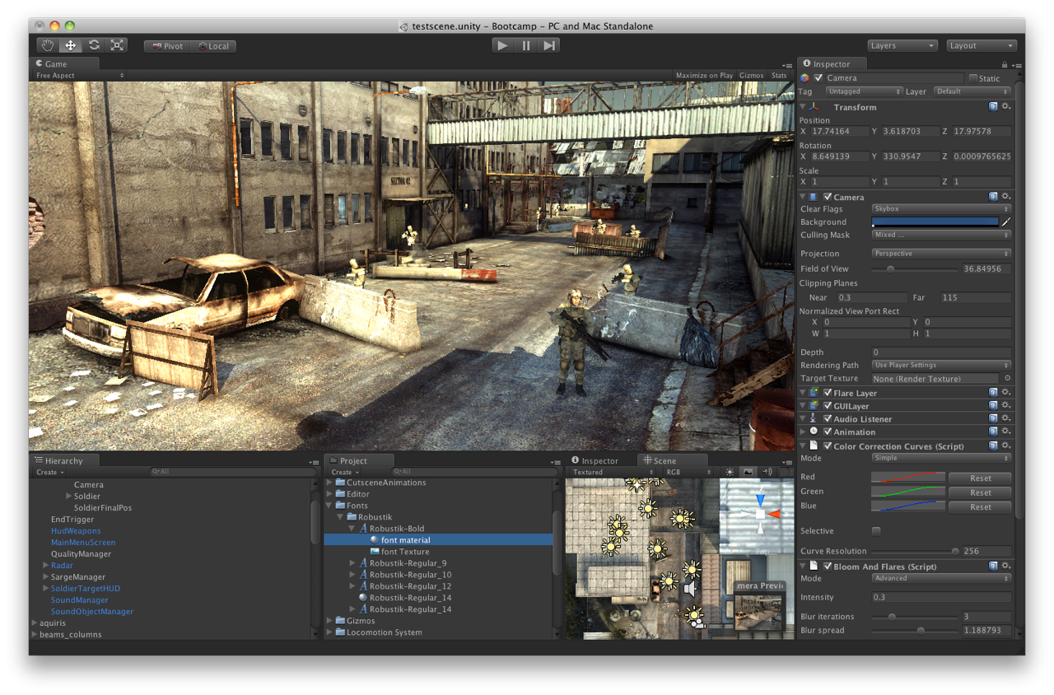

Slide 10
Intro to Game Maker

Slide 11
Basic Elements
Sprites - 2D Art Assets (use PNG)
Objects - rule governed entities
Rooms - Each scene/level/environment

Slide 12
Example starter shooting game for GMS
download
Notes:
this is for gms, so it may not work on gamemaker mac

Slide 13

Teamtime
go team, go?

Slide 14
Things to be decided...
Divided responsibilities… who is doing what?
Which software will you be using? e.g. GMS, Unity, Photoshop, etc.
What are your goals for your project by the start of class next week? Who is responsible for ensuring this goal is complete (everyone needs at least one)?
When are you meeting?
15 MINUTES

Slide 15
GAME 1 PRESENTATIONS?

Slide 16
GAME 1 PRESENTATIONS?
NEXT WEEK 3/29/16?

Slide 17
Freaking out yet?

Slide 18
GAME 1 GAME DESIGN DOCUMENT
NEXT WEEK 3/29/16

Slide 19
GAME 1 GAME DESIGN DOCUMENT
NEXT WEEK 3/29/16
GAME 1 PRESENTATIONS / PLAY SESSION
2 WEEKS FROM NOW 4/5/16

Slide 20
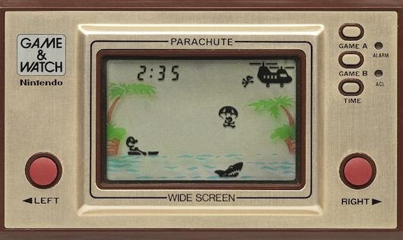
Pica Pic
R.I.P. 1970’s-1990’s

Slide 21
HOMEWORK
RGR4
READ Level Up Chapter 12
PLAY Play one handheld game you like and two you dislike on Pica Pic
WRITE Relate the reading to the handheld games you played. What were the key mechanics? What worked? What was frustrating? etc.
GDD - Week 8 (3/29/16) - Post a link to the blog, clearly labelled with team member names
Game 1 Projects/Presentations -- Week 9 (4/5/16)

